Slide 1

Heart Failure Prediction [DAB 304 – 006]
Group Members:
Surbhi Patel
Richa Patel
Dharmikkumar patel
Raj Bhalodwala
Joyal Patel

Slide 2
Introduction
According to estimates, 17.9 million people (about the population of New York) die from cardiovascular diseases (CVDs) each year, which accounts for 31% of all fatalities worldwide. Heart attacks and strokes account for four out of every five CVD fatalities, with premature deaths accounting for one-third of these deaths among those under the age of 70. This dataset comprises 11 variables that can be used to predict a potential heart illness. Heart failure is a common occurrence brought on by CVDs.
A machine learning model can be very helpful in the early diagnosis and care of people with cardiovascular disease or who are at high cardiovascular risk (due to the presence of one or more risk factors including hypertension, diabetes, hyperlipidaemia, or previously existing illness).

Slide 3
Business Objectives
To develop machine learning model to predict future possibility of heart disease. Which model gives better accuracy to predict future possibility of heart disease.
To determine significant risk factors based on medical dataset which may lead to heart disease.
To analyze feature selection methods and understand their working principle.

Slide 4
Methodology
Data Collection
Data Cleaning (MS Excel, Python)
Exploratory Data Analysis (Python)
Data Visualization (Python)
Build and apply suitable algorithms (Python)
Outcome

Slide 5
Data Collection
The dataset is publicly available on the Kaggle Website.
It provides patient information which includes over 918 records and 12 attributes.
The attributes include Age, Sex, ChestPainType, RestingBP, Cholesterol, FastingBS, RestingECG, MaxHR, ExerciseAngina, Oldpeak, ST_Slope, HeartDisease.
The data set is in csv (Comma Separated Value) format which is further prepared to data frame as supported by pandas library in python.
Dataset link: Heart Failure Prediction Dataset | Kaggle

Slide 6
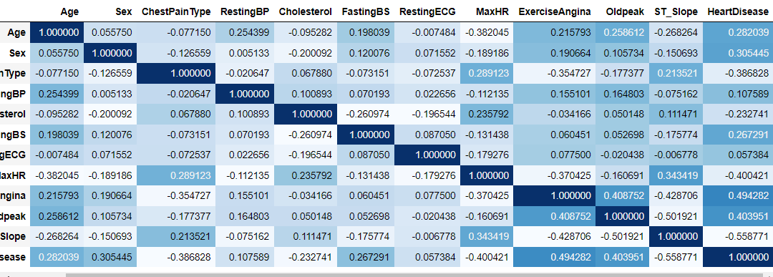
EDA (Exploratory Data Analysis)
It shows that there is no single feature that has a very high correlation with our target value. Also, some of the features have a negative correlation with the target value and some have positive.

Slide 7
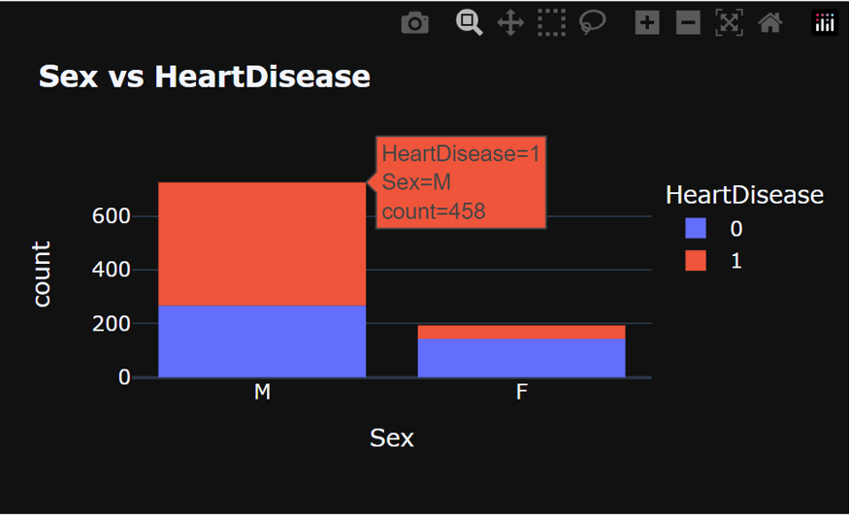
Data Visualization
The ratio of having heart problem in a person is almost equal to the person not having a heart disease. While comparing for male and female the ratio of having heart disease is much more in Male that is 400 counts higher than having in Female.

Slide 8
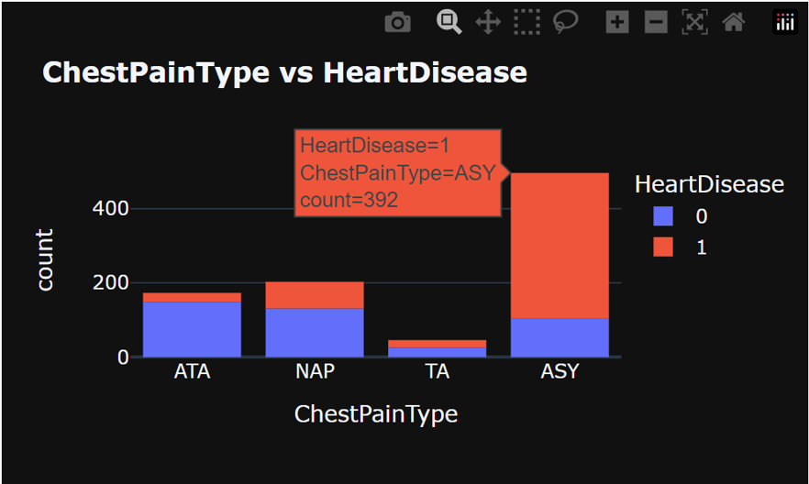
For the chest pain patient with ASY type pain has the highest ratio of heart disease with 400 counts whereas for other types the numbers of patient are below 100. TA has almost balanced ratio of heart patient.

Slide 9
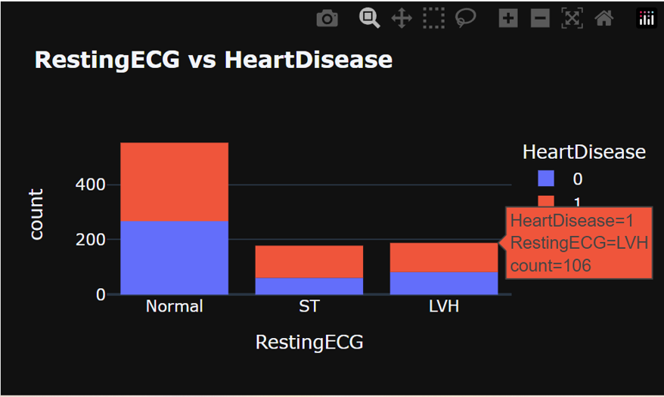
Measuring the heart disease for RestingECG of normal patient has equal chance of having heart disease and for the rest of the ratio is almost same but less than normal patient.

Slide 10
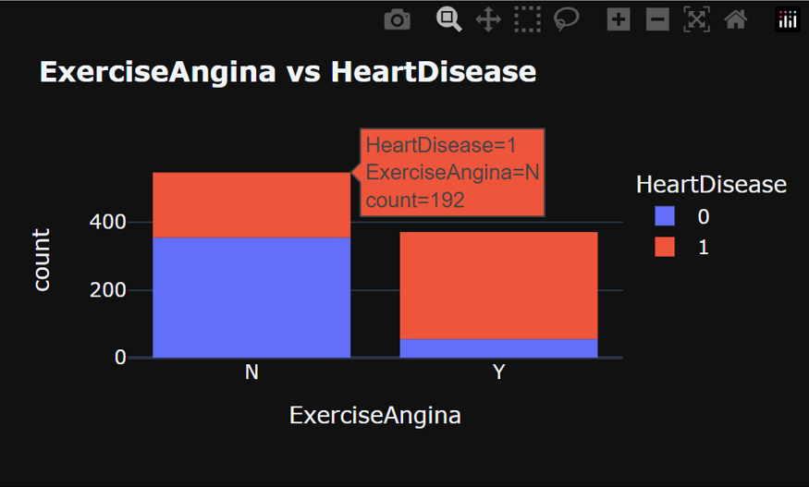
The patient who has ExerciseAngina has more heart problems and if they don’t have Exercise Angina then the ratio of not having heart disease is very more. So ExerciseAngina is directly proportional to heart rate.

Slide 11
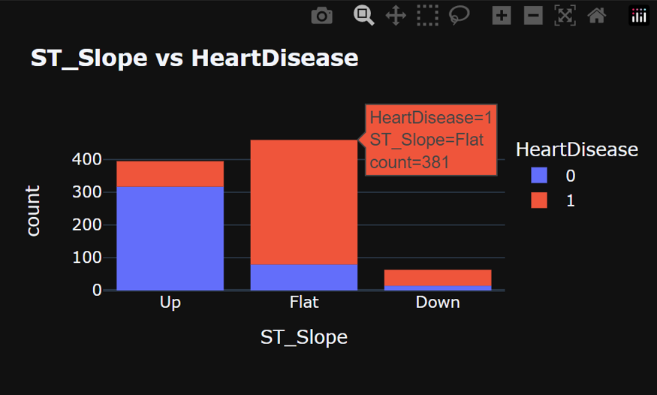
For ST_Slope if the slope is up there are very low chance of having heart problems whereas for flat slope it is opposite. Whereas for Down ST_Slow both disease and no-disease have very less ratio compared to up and Flat slop.

Slide 12
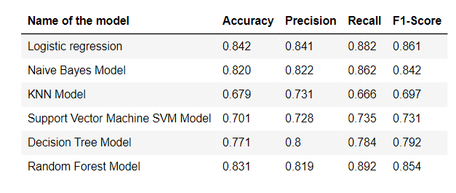
Model Selection
From the table of the accuracy for different model, it can be said that logistic regression gives a better accuracy as compared to another model. But the highest recall score is 0.892 for the random forest model.
Overall, we can say that logistic regression gives a better result.

Slide 13
Outcomes
Overall, we can conclude from the given data that the ratio of the heart diseases is higher in Male that is 55%. For the chest pain patient with ASY type pain has the highest ratio of heart disease with 400 counts.
Measuring the heart disease of normal patient has equal chance of having heart disease and for the rest the ratio is 1:10. For ST_Slope if the slope is up there are very low chance of having heart problems whereas for flat slope it is opposite. The patient who has ExerciseAngina has more heart problems and if they don’t have Exercise Angina then the ratio of not having heart disease is very more. So ExerciseAngina is directly proportional to heart rate.
It shows that there is no single feature that has a very high correlation with our target value. Also, some of the features have a negative correlation with the target value and some have positive.
After performing Accuracy on every model, we can conclude that the Logistic Regression gives the best result out of all the model for the data accuracy test.

Slide 14
Thank you

